Slide 1
Aerothermochemistry and Combustion
DAY 10
Kumaresh
2024/05/20

Slide 2
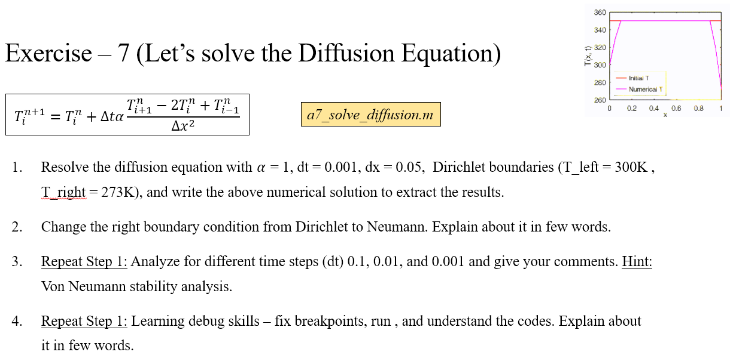
Quick Recap
Notes:
https://ezgif.com/maker
Dirichlet boundary conditions assume the solution to the variable.
In Neumann boundary conditions, a solution is assumed for the derivative of the variable.
https://en.wikipedia.org/wiki/Von_Neumann_stability_analysis

Slide 3
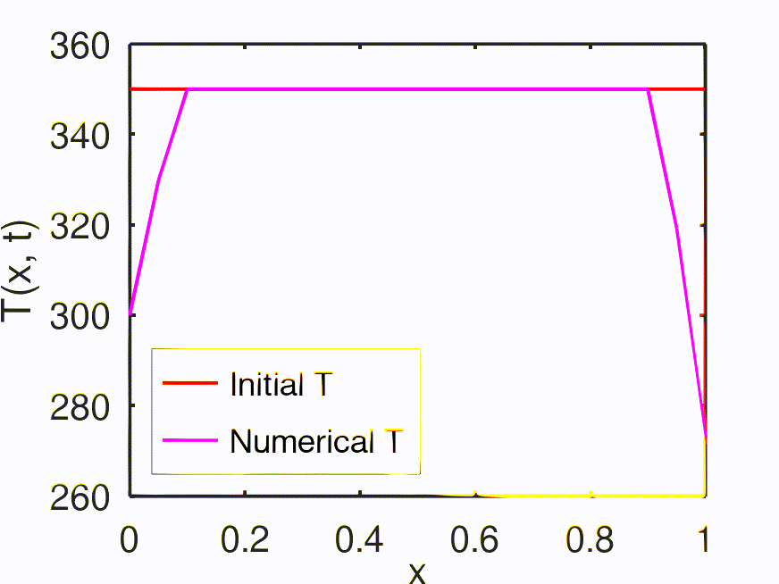
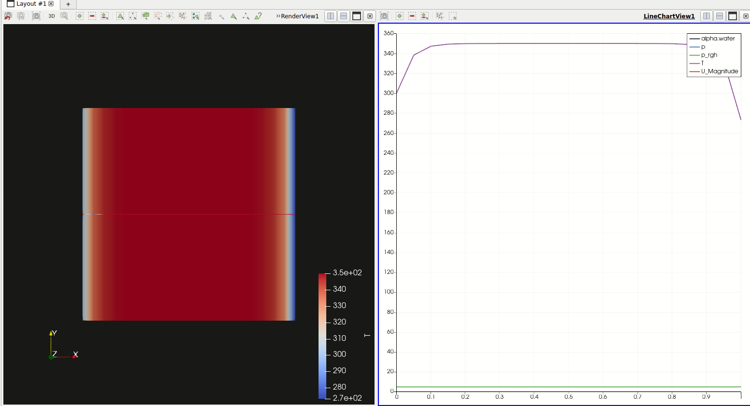
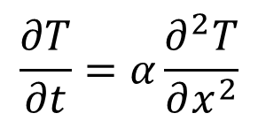
Quick Recap – Project 1
Paraview – Post Processing tool in OpenFOAM
$$\frac{∂T}{∂t}=α\frac{∂^{2}T}{∂x^{2}}$$
Notes:
https://ezgif.com/maker
Dirichlet boundary conditions assume the solution to the variable.
In Neumann boundary conditions, a solution is assumed for the derivative of the variable.
https://en.wikipedia.org/wiki/Von_Neumann_stability_analysis

Slide 4
Contents
Global Mechanism – single step reaction
Rate of the reaction
Relation Between Rate Coefficients and Equilibrium Constants
Exercise – 7

Slide 5
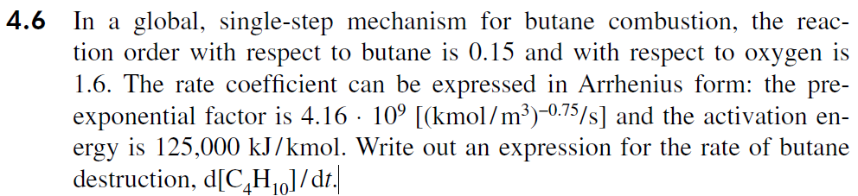
Exercise – 8
4.7)
Using the results of problem 4.6, determine the volumetric mass oxidation rate of butane, in kg/s-m³, for a fuel–air mixture with an equivalence ratio of 0.9, temperature of 1200 K, and pressure of 1 atm.

Slide 6
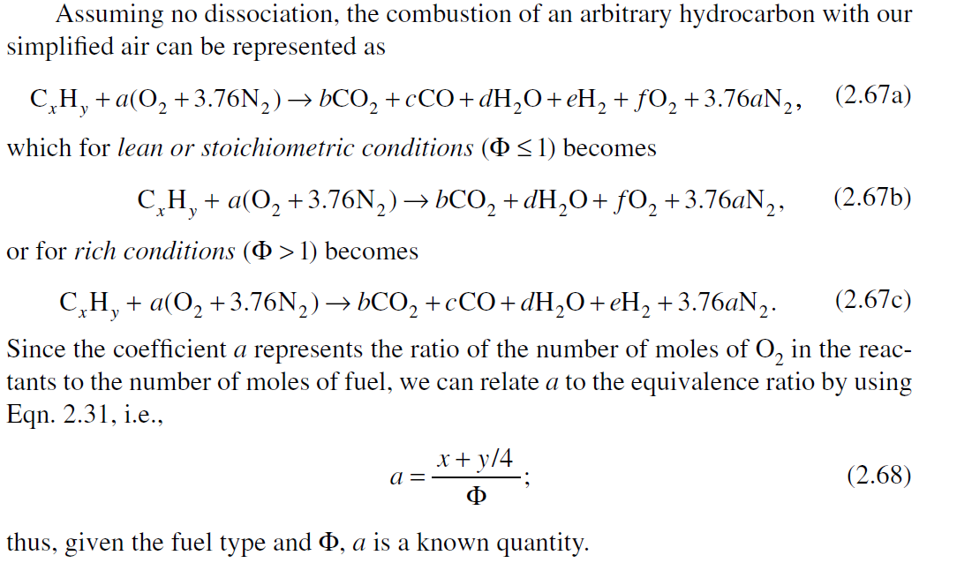
Global Mechanism – single step reaction
STEP 1:

Slide 7
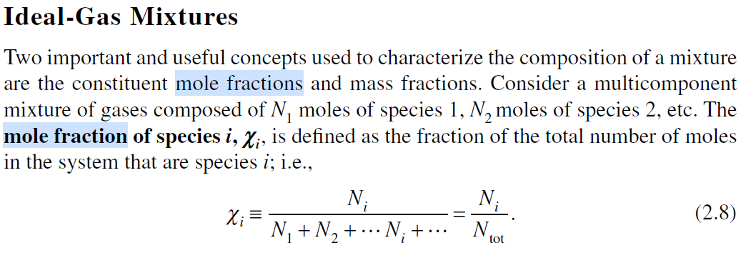
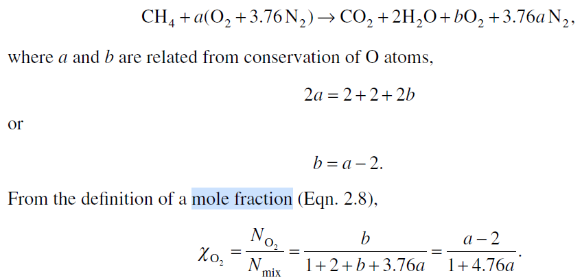
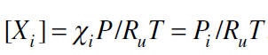
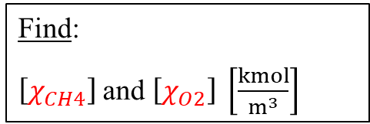
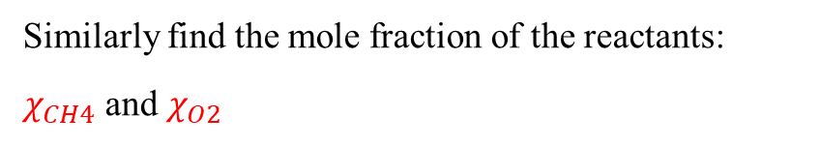
Mole fraction calculation
STEP 2:
The molar concentrations relate to the mole fractions and partial pressures as follows,
Similarly find the mole fraction of the reactants:
$χ_{CH4}$ and $χ_{O2}$
Find:
$\left[χ_{CH4}\right]$and $\left[χ_{O2}\right] \left[\frac{kmol}{m^{3}}\right]$

Slide 8
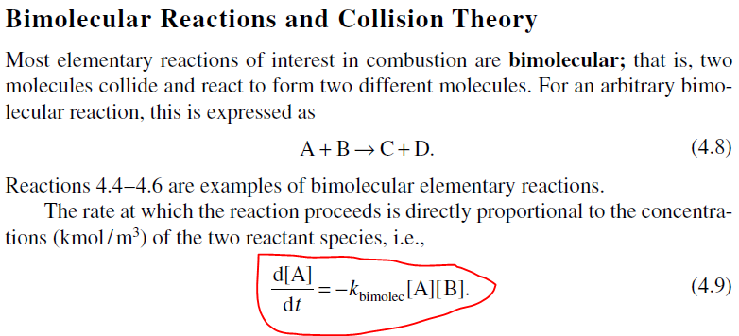
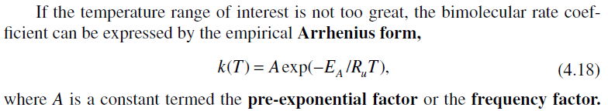
Rate of the reaction
STEP 3:
mass oxidation rate ($m_{CH4}^{′′′}$) = $\frac{d\left[C_{4}H_{10}\right]}{dt}×MW$ = $\left[\frac{kmol}{m^{3}. s}\right]$ $×\left[\frac{kg}{kmol}\right]$ = $\left[\frac{kg}{m^{3}. s}\right]$

Slide 9
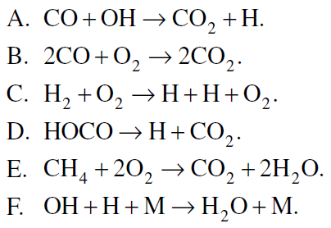
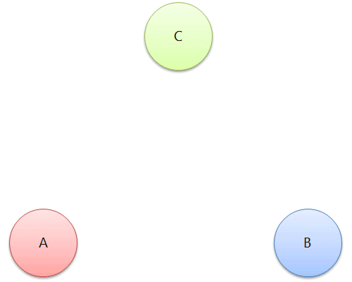

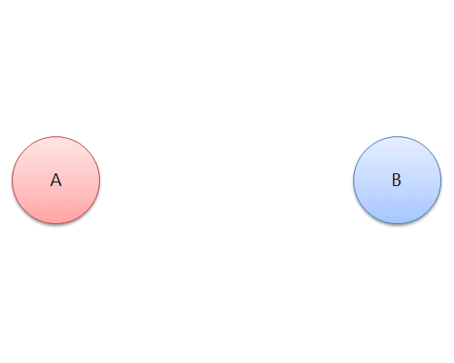
Exercise – 8
4.8)
Classify the following reactions as being either global or elementary. For those identified as elementary, further classify them as unimolecular, bimolecular, or termolecular. Give reasons for your classification.
Illustrations of unimolecular, bimolecular and termolecular reactions [1]
Notes:
[1] https://chem.libretexts.org/Courses/University_of_Arkansas_Little_Rock/Chem_1403%3A_General_Chemistry_2/Text/14%3A_Rates_of_Chemical_Reactions/14.07%3A_Reaction_Mechanisms

Slide 10
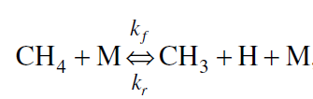
Exercise – 8
4.10)
In methane combustion, the following reaction pair is important.
where the reverse reaction coefficient is given by
At 1500 K, the equilibrium constant K_{p} has a value of 0.003691 based on a reference-state pressure of 1 atm (101,325 Pa). Derive an algebraic expression for the forward rate coefficient k_{f} . Evaluate your expression for a temperature of 1500 K. Give units.

Slide 11
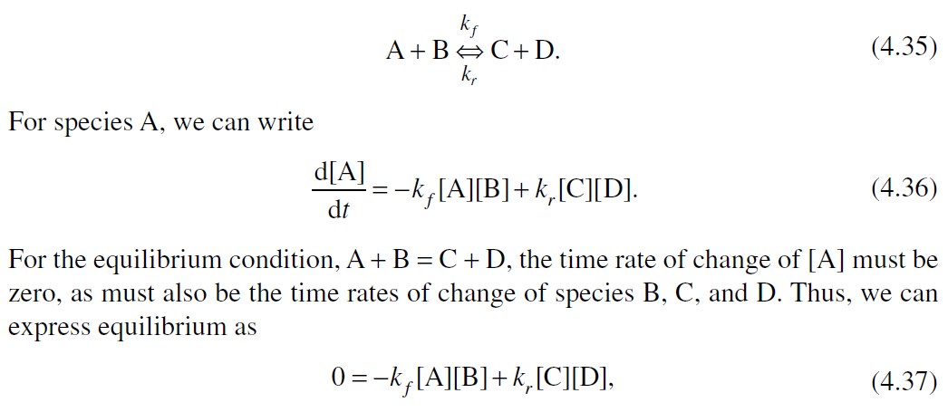
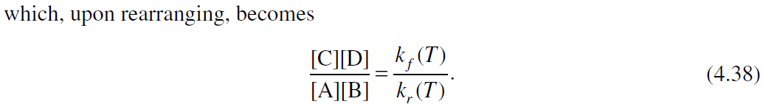
Relation Between Rate Coefficients and Equilibrium Constants
For example, consider both the forward and reverse rates for the arbitrary bimolecular reaction:
STEP 1:

Slide 12
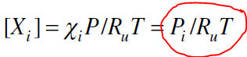
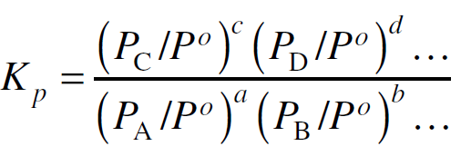
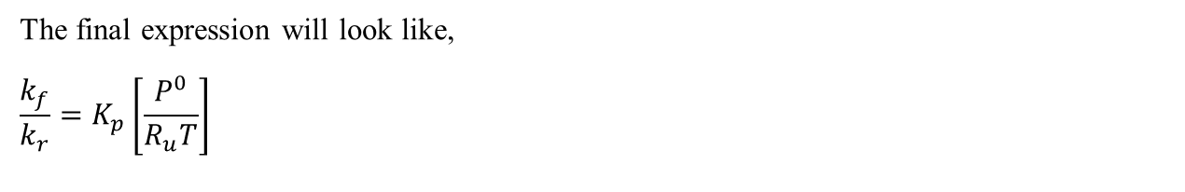
Relation Between Rate Coefficients and Equilibrium Constants
Derive the expressions for k_{f} / k_{r} in the form of molar concentrations, keeping R_{u} and T as constant.
STEP 2:
Divide the expression of k_{f} / k_{r} by reference-state std. pressure (P⁰) and replace the particular term with K_{p}
STEP 3:
The final expression will look like,
$$\frac{k_{f}}{k_{r}}=K_{p}\left[\frac{P^{0}}{R_{u}T}\right]$$
Evaluate this expression and give units.

